Slide 1


Final Presentation
TEAM 1A
Member Name
Nabiha Orchi
Sai Lochan
Adewale Adeniji
Shreya Wani
Aisha Hassan
Haruna Yusuf
Derrick Addo

Slide 2
Introduction
During our internship, we worked on data cleaning, validation, and visualization using user and opportunity data. Our key achievement was developing a four-page interactive dashboard that provides valuable insights through various visualizations.
Additionally, we analyzed the data to derive actionable recommendations and conclusions, which we are excited to share. This project enhances decision-making by offering a clear, interactive representation of trends and opportunities.
Our analysis also includes demographic insights, such as gender distribution, current majors or degrees, and country-wise representation, providing a deeper understanding of user engagement and trends.

Slide 3
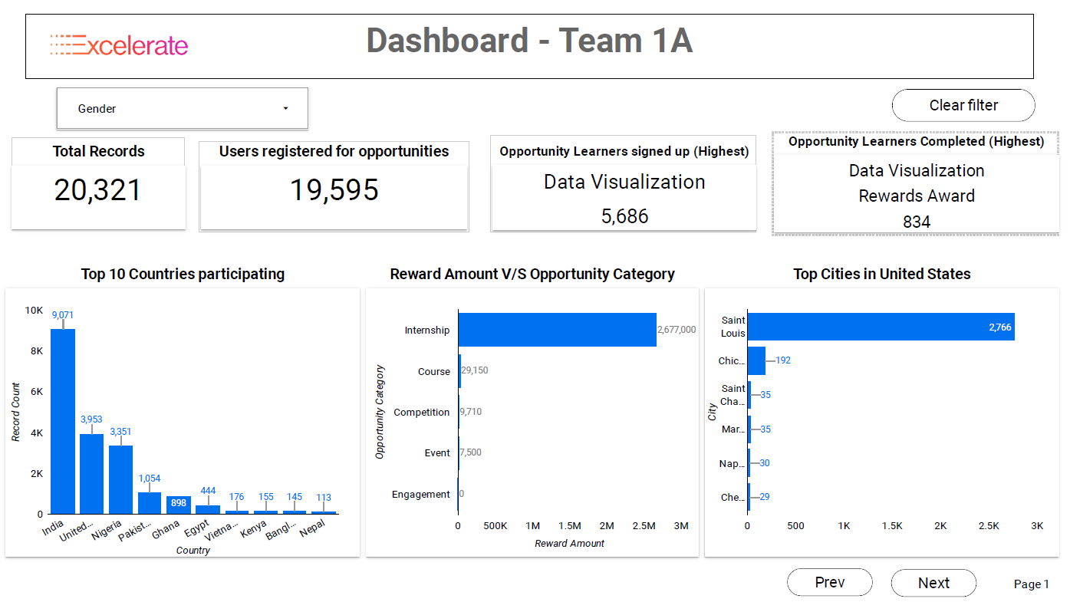
Dashboard Overview

Slide 4
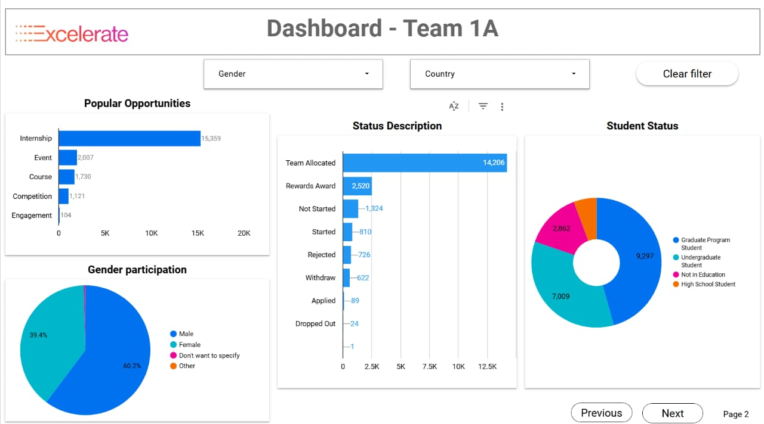
User Engagement & Demographics

Slide 5
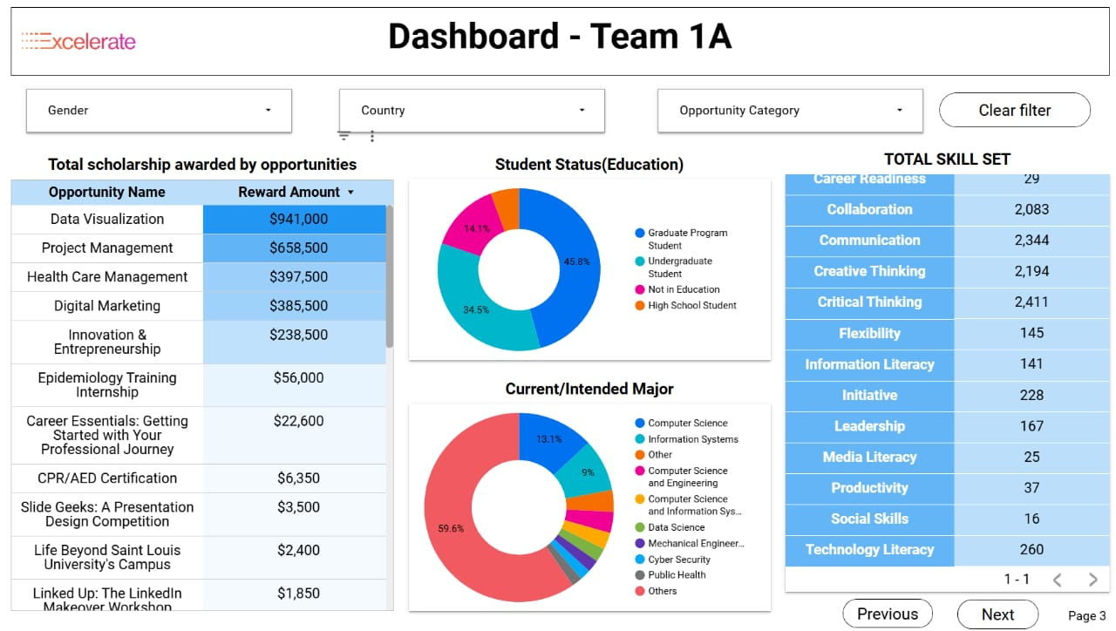
Scholarship Awards & Skills Development

Slide 6
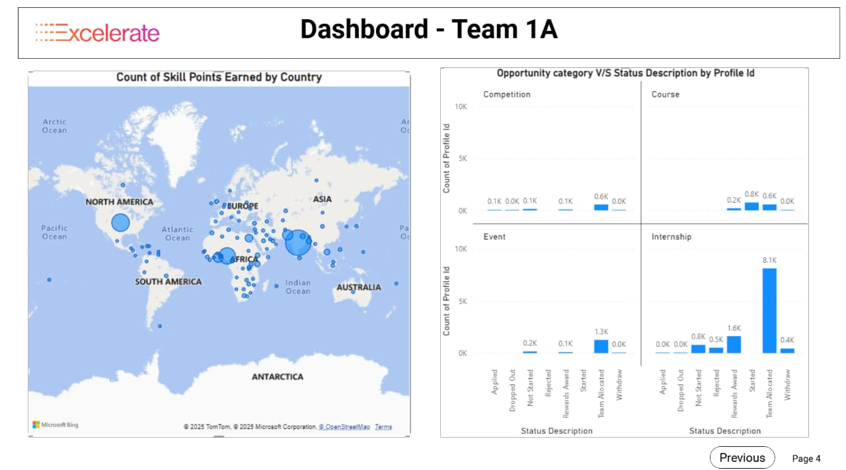
Scholarship Awards & Skills Development

Slide 7
Dashboard Insights Summary
Funding Overview
Data Visualization leads with $941K in funding, followed by Project Management ($658K), Health Care Management ($397K), and Digital Marketing ($385K).
Education & Major Distribution
Nearly half (45.8%) are graduate students, while 34.5% are undergraduates. The remaining students are either not in education (14.1%) or in high school (5.6%). Most students (59.6%) come from diverse fields, with Computer Science (13.1%) and Information Systems (9%) being notable concentrations.
Skills Assessment
Top performers demonstrate strong Critical Thinking (2,411 points), Communication (2,344), Creative Thinking (2,194), and Collaboration (2,083). Areas needing development include Social Skills (16), Media Literacy (25), and Productivity (37). Skill points are primarily distributed across North America, Europe, and Africa.
Opportunity Engagement
Internships show significant initial interest (8.1K starts) with 1.6K successful completions and 0.4K withdrawals
Courses: 800 enrollments with 600 completions
Events have facilitated 1.3K team placements
Competition participation remains low

Slide 8
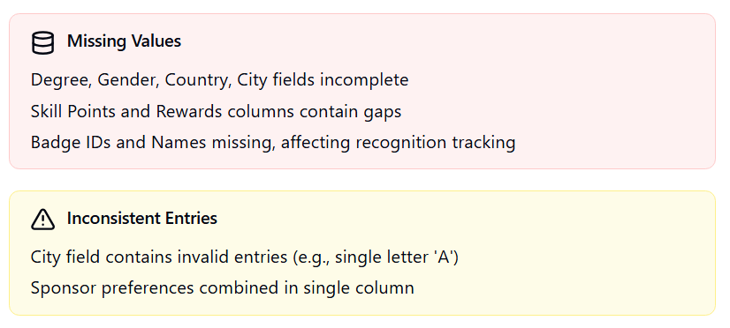
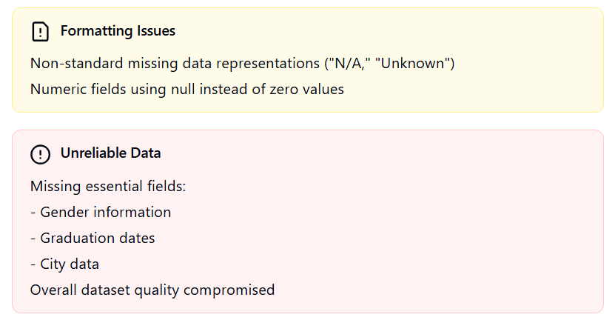
Data Cleaning Challenges

Slide 9
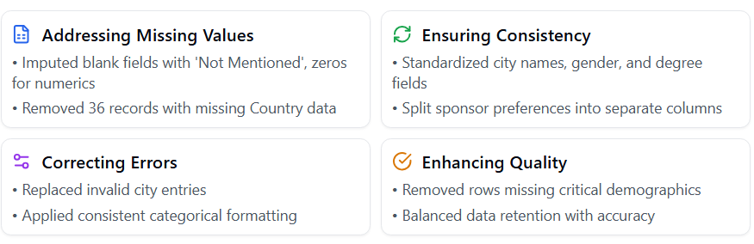
Data Cleaning Solutions

Slide 10
Recommendations
Enhancing Data Utilization.
Optimize Scholarship Distribution: Reallocate funds to underrepresented skills and education areas for better impact.
Increase Completion Rates: Offer mentorship programs, incentives, and support to boost internship and course completions.
Targeted Skill Development: Focus on improving Social Skills, Media Literacy, and Productivity through tailored workshops.
Boost Engagement in Competitions: Encourage participation through rewards, gamification, and recognition programs.
Expand Geographic Reach: Leverage insights from skill distribution data to provide better support across regions.

Slide 11
Conclusion
To conclude, our analysis, using EDA and visualizations, provided key insights into user engagement, funding, and skill development. The interactive dashboard simplifies complex data, ensuring better decision-making. Data cleaning and validation improved accuracy, highlighting areas for growth like course completion and skill enhancement. This project demonstrates the power of data visualization in driving actionable insights.

Slide 12


